Slide 1
SDSU –College of Engineering Electrical and Computer Engineering
FM MUSIC SYNTHESIZER IN FPGA
Notes:
TITO

Slide 2

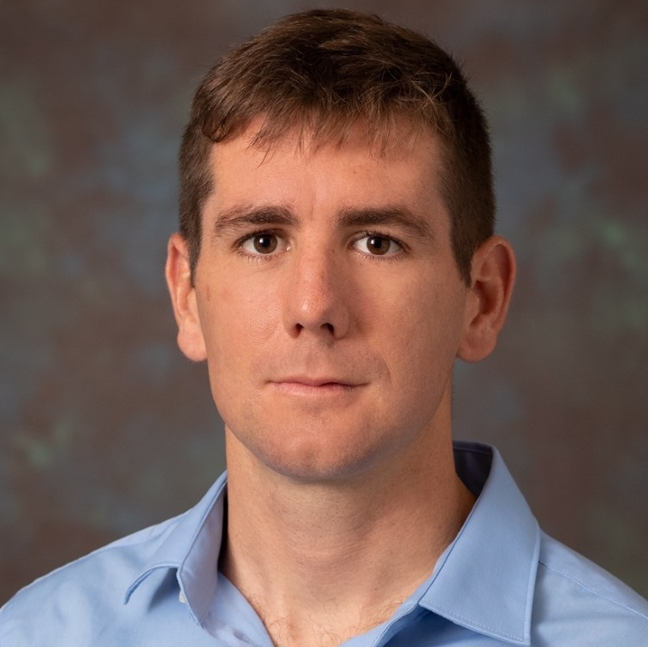
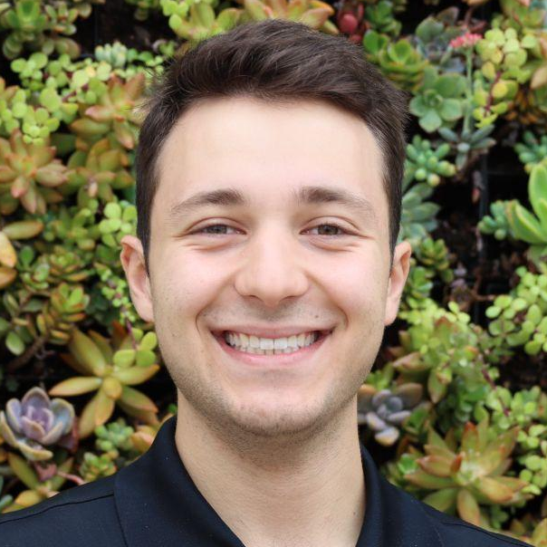


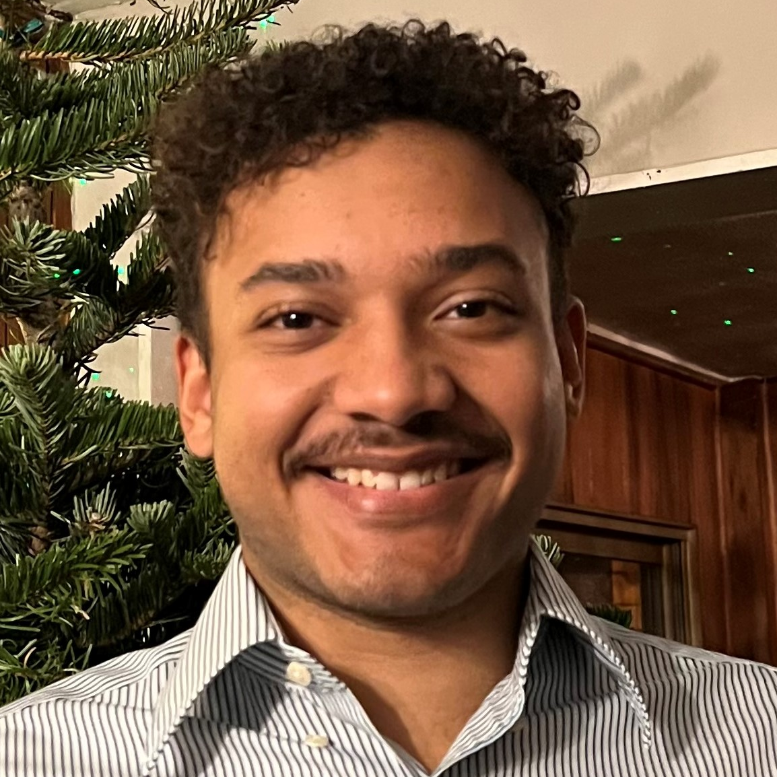
The Team
Abdullah Altawheed
EE
Michael Fallon
EE
Tiber Hernandez
CompE
Andres Medina
EE
Tharaa Rahhal
EE
Elisha Reece
CompE

Slide 3
Summary
System Description – what it does
What makes it unique
Key Technologies – what technology is used
Skills required – what we learned at school
Knowledge gained – what we learned at sd
Application of knowledge
Conclusion

Slide 4
System Description
Digital Data From MIDI
Optocoupler for Isolation
UART data into FPGA
Process MIDI commands in CPU
Generate and Modulate Notes
Convert to Analog
Output to Speaker

Slide 5
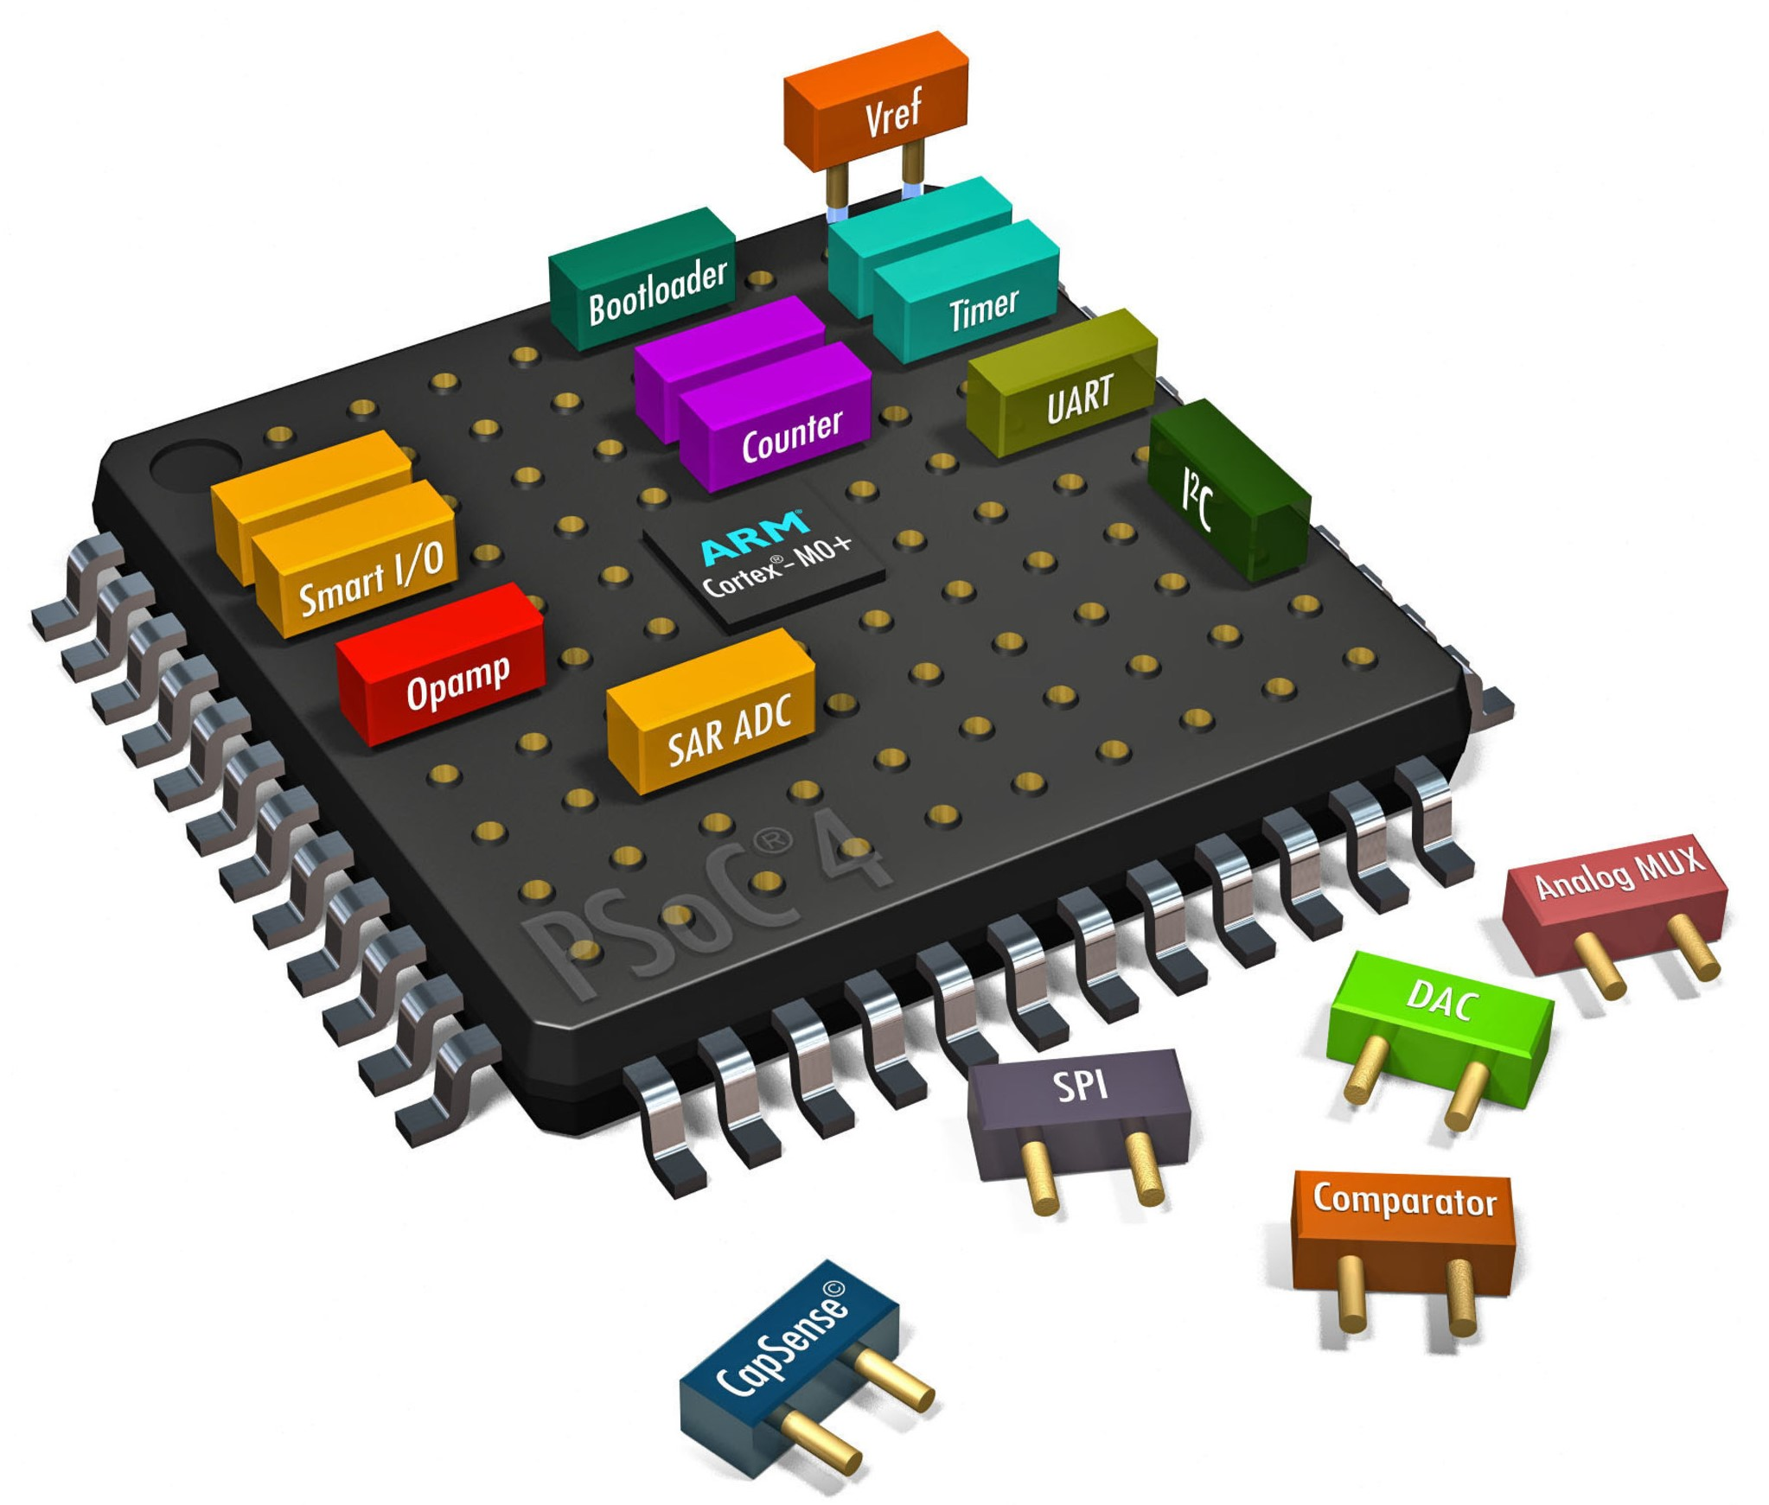
Key Technology – System-On-Chip (SoC) Processor and FPGA in one chip
What is an Field Programmable Gate Array?
Custom hardware
Less power consumption
Reduce latency
Why do we need a Processor?
Optimized for software programs
Efficiently handles conditional states
Notes:
MICHAEL

Slide 6
Why is latency important
Latency - The time it takes for an input to produce an output
Too much latency results in Lag
CPU’s take tens/hundreds of clock cycles for trigonometry
FPGA’s are orders of magnitude faster due to custom hardware
Notes:
MICHAEL

Slide 7

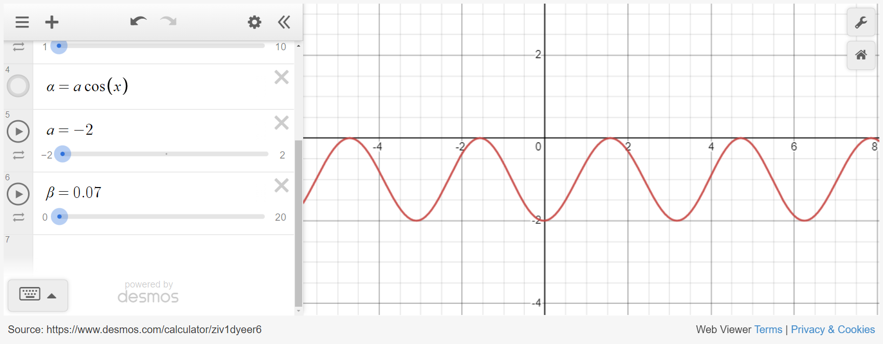
Frequency Modulation
The modulation of a signal or audio wave by dynamically changing its frequency.
$$FM=αcos(ct+βcos\left(mt\right))$$

Slide 8
Power Supply
THARAA
Notes:
THARRA OUR DEVICE TAKES MIDI INPUT AND OUTPUTS SOUND INTO SPEAKERS

Slide 9
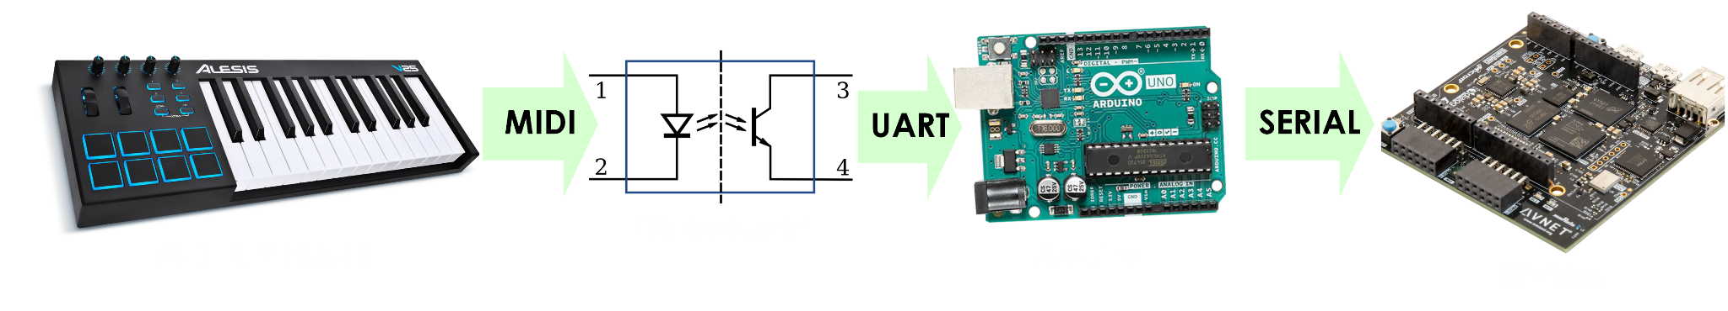

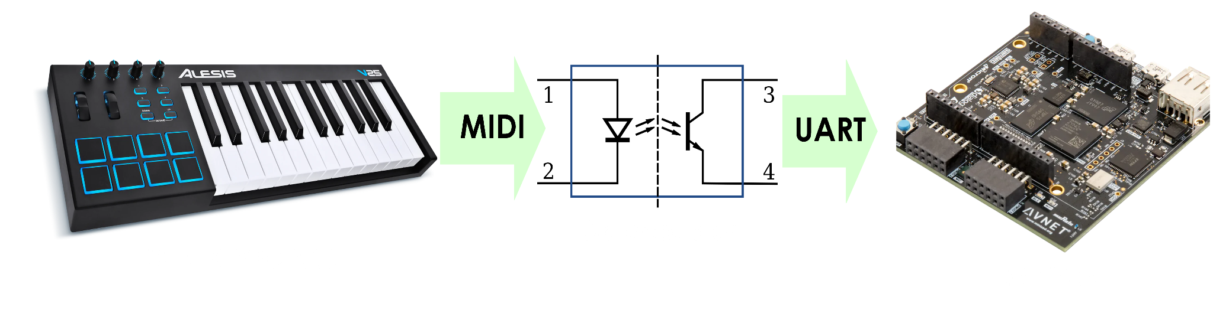
Datapath - Keyboard to SoC
Path one - off ramp
OR
Path two - stretch
Notes:
ELI

Slide 10
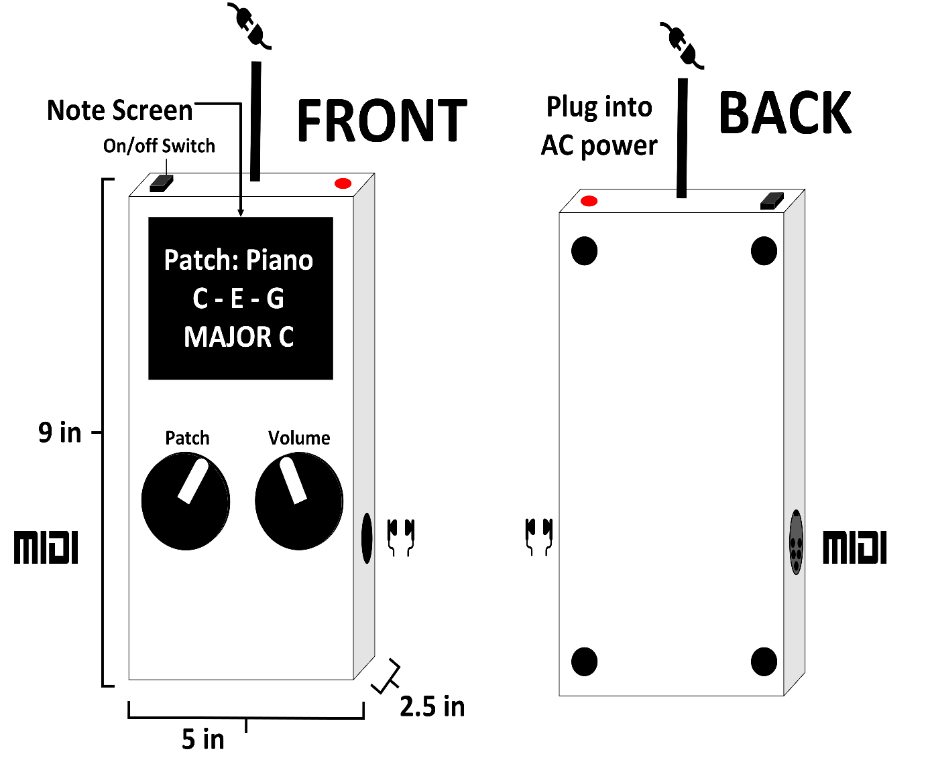
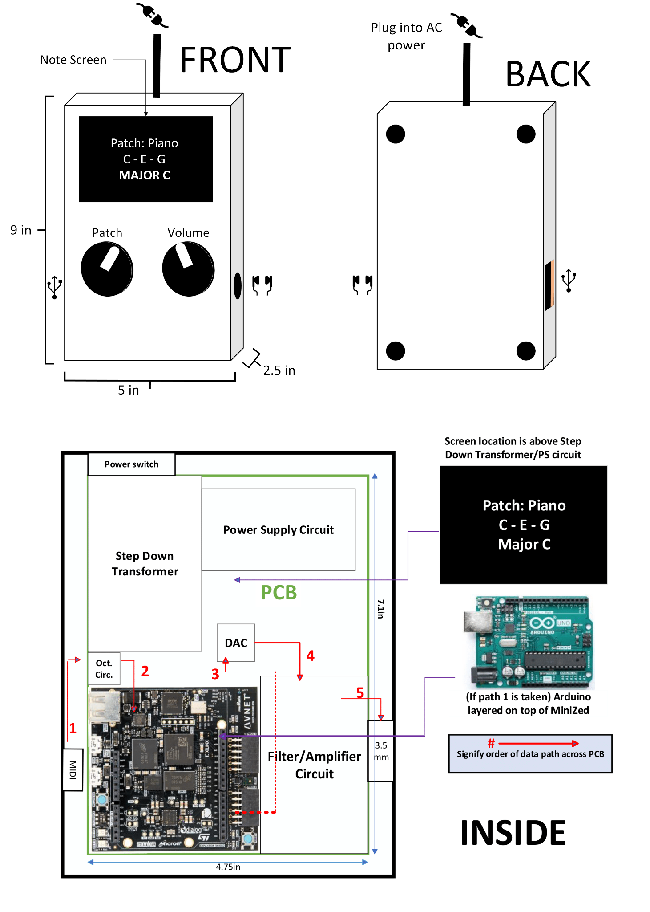
Physical description
NOT TO SCALE
Notes:
ABDUL

Slide 11
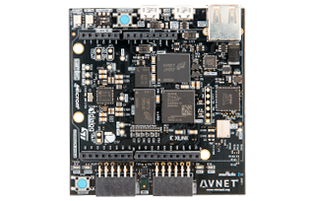
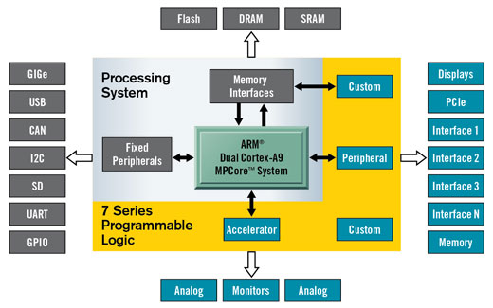
System on Chip (SoC)
Dedicated Processor
Flexibility of GPP
Accessibility of software code
Generate user defined, phase coherent clocks
Programmable Logic Fabric
Fully customizable hardware
Parallel computational units
Able to accelerate functionality using faster clocks and dedicated hardware
Notes:
MICHAEL

Slide 12
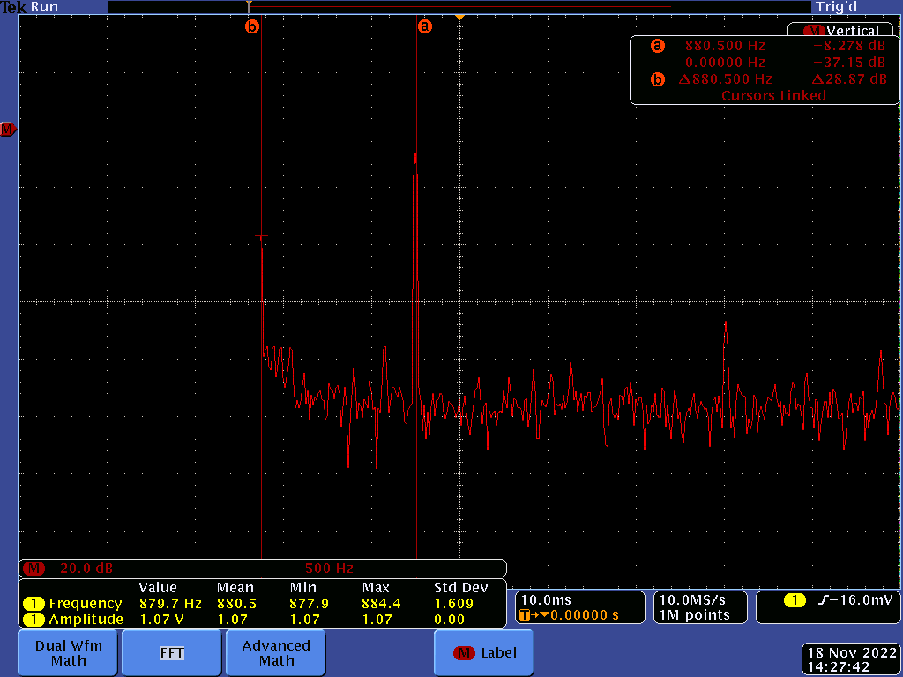
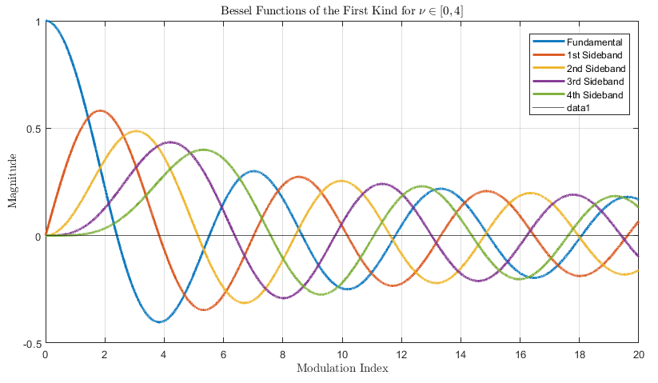
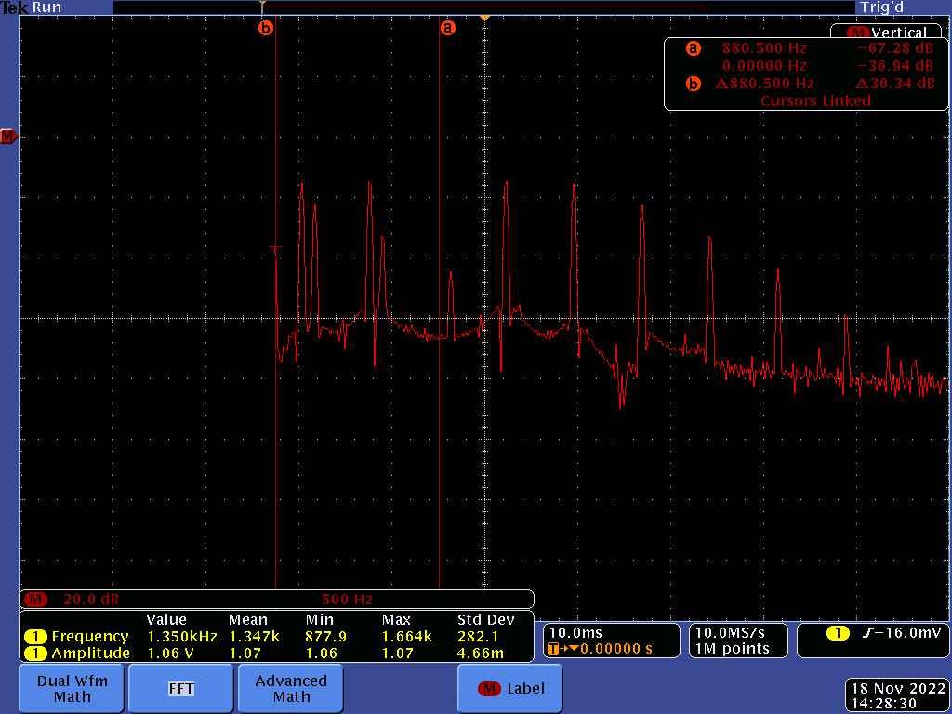
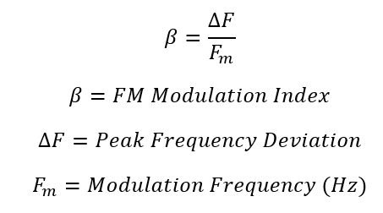
FM SYSTEM TEST
880 Hz
non-modulated sine wave
880 Hz
modulated sine wave

Slide 13
Key Technological Challenges
Not everyone can play by ear

Slide 14
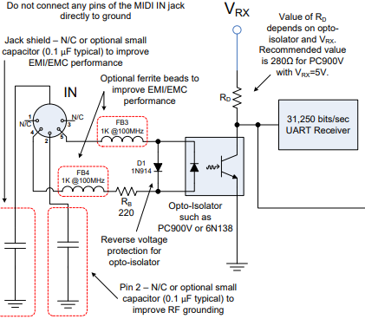

Technological Challenges - EMBEDDED
Utilizing Xilinx proprietary IDE (Vivado/Vitis) & learning integration
Parsing MIDI data from keyboard
Porting over Arduino code/functions to bare-metal processor (Path 2)
Notes:
Tito

Slide 15
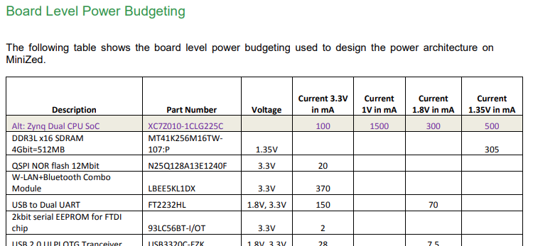

Technological Challenges - ELECTRICAL
Design power supply to meet component power requirements
Design Filter/Amplifier circuit
Design PCB and integrate/mount all components.
Power supply, MiniZed, DAC, filter/amplifier
Notes:
Tharaa

Slide 16
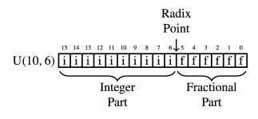
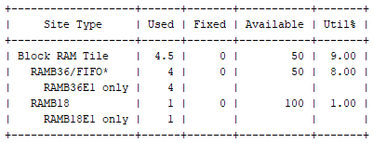
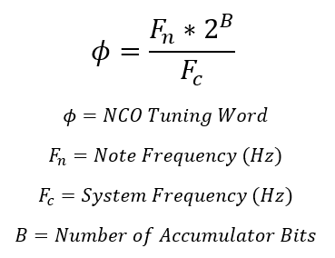
Technological Challenges - FPGA
Implementing fixed point arithmetic units
Balancing memory resources with signal resolution
Calculating optimal datapath bit-width
Calculating tuning words
Integrating FPGA fabric with Hard Processor

Slide 17
Risk Analysis and Prototype Activity
The soundcheck before the gig

Slide 18
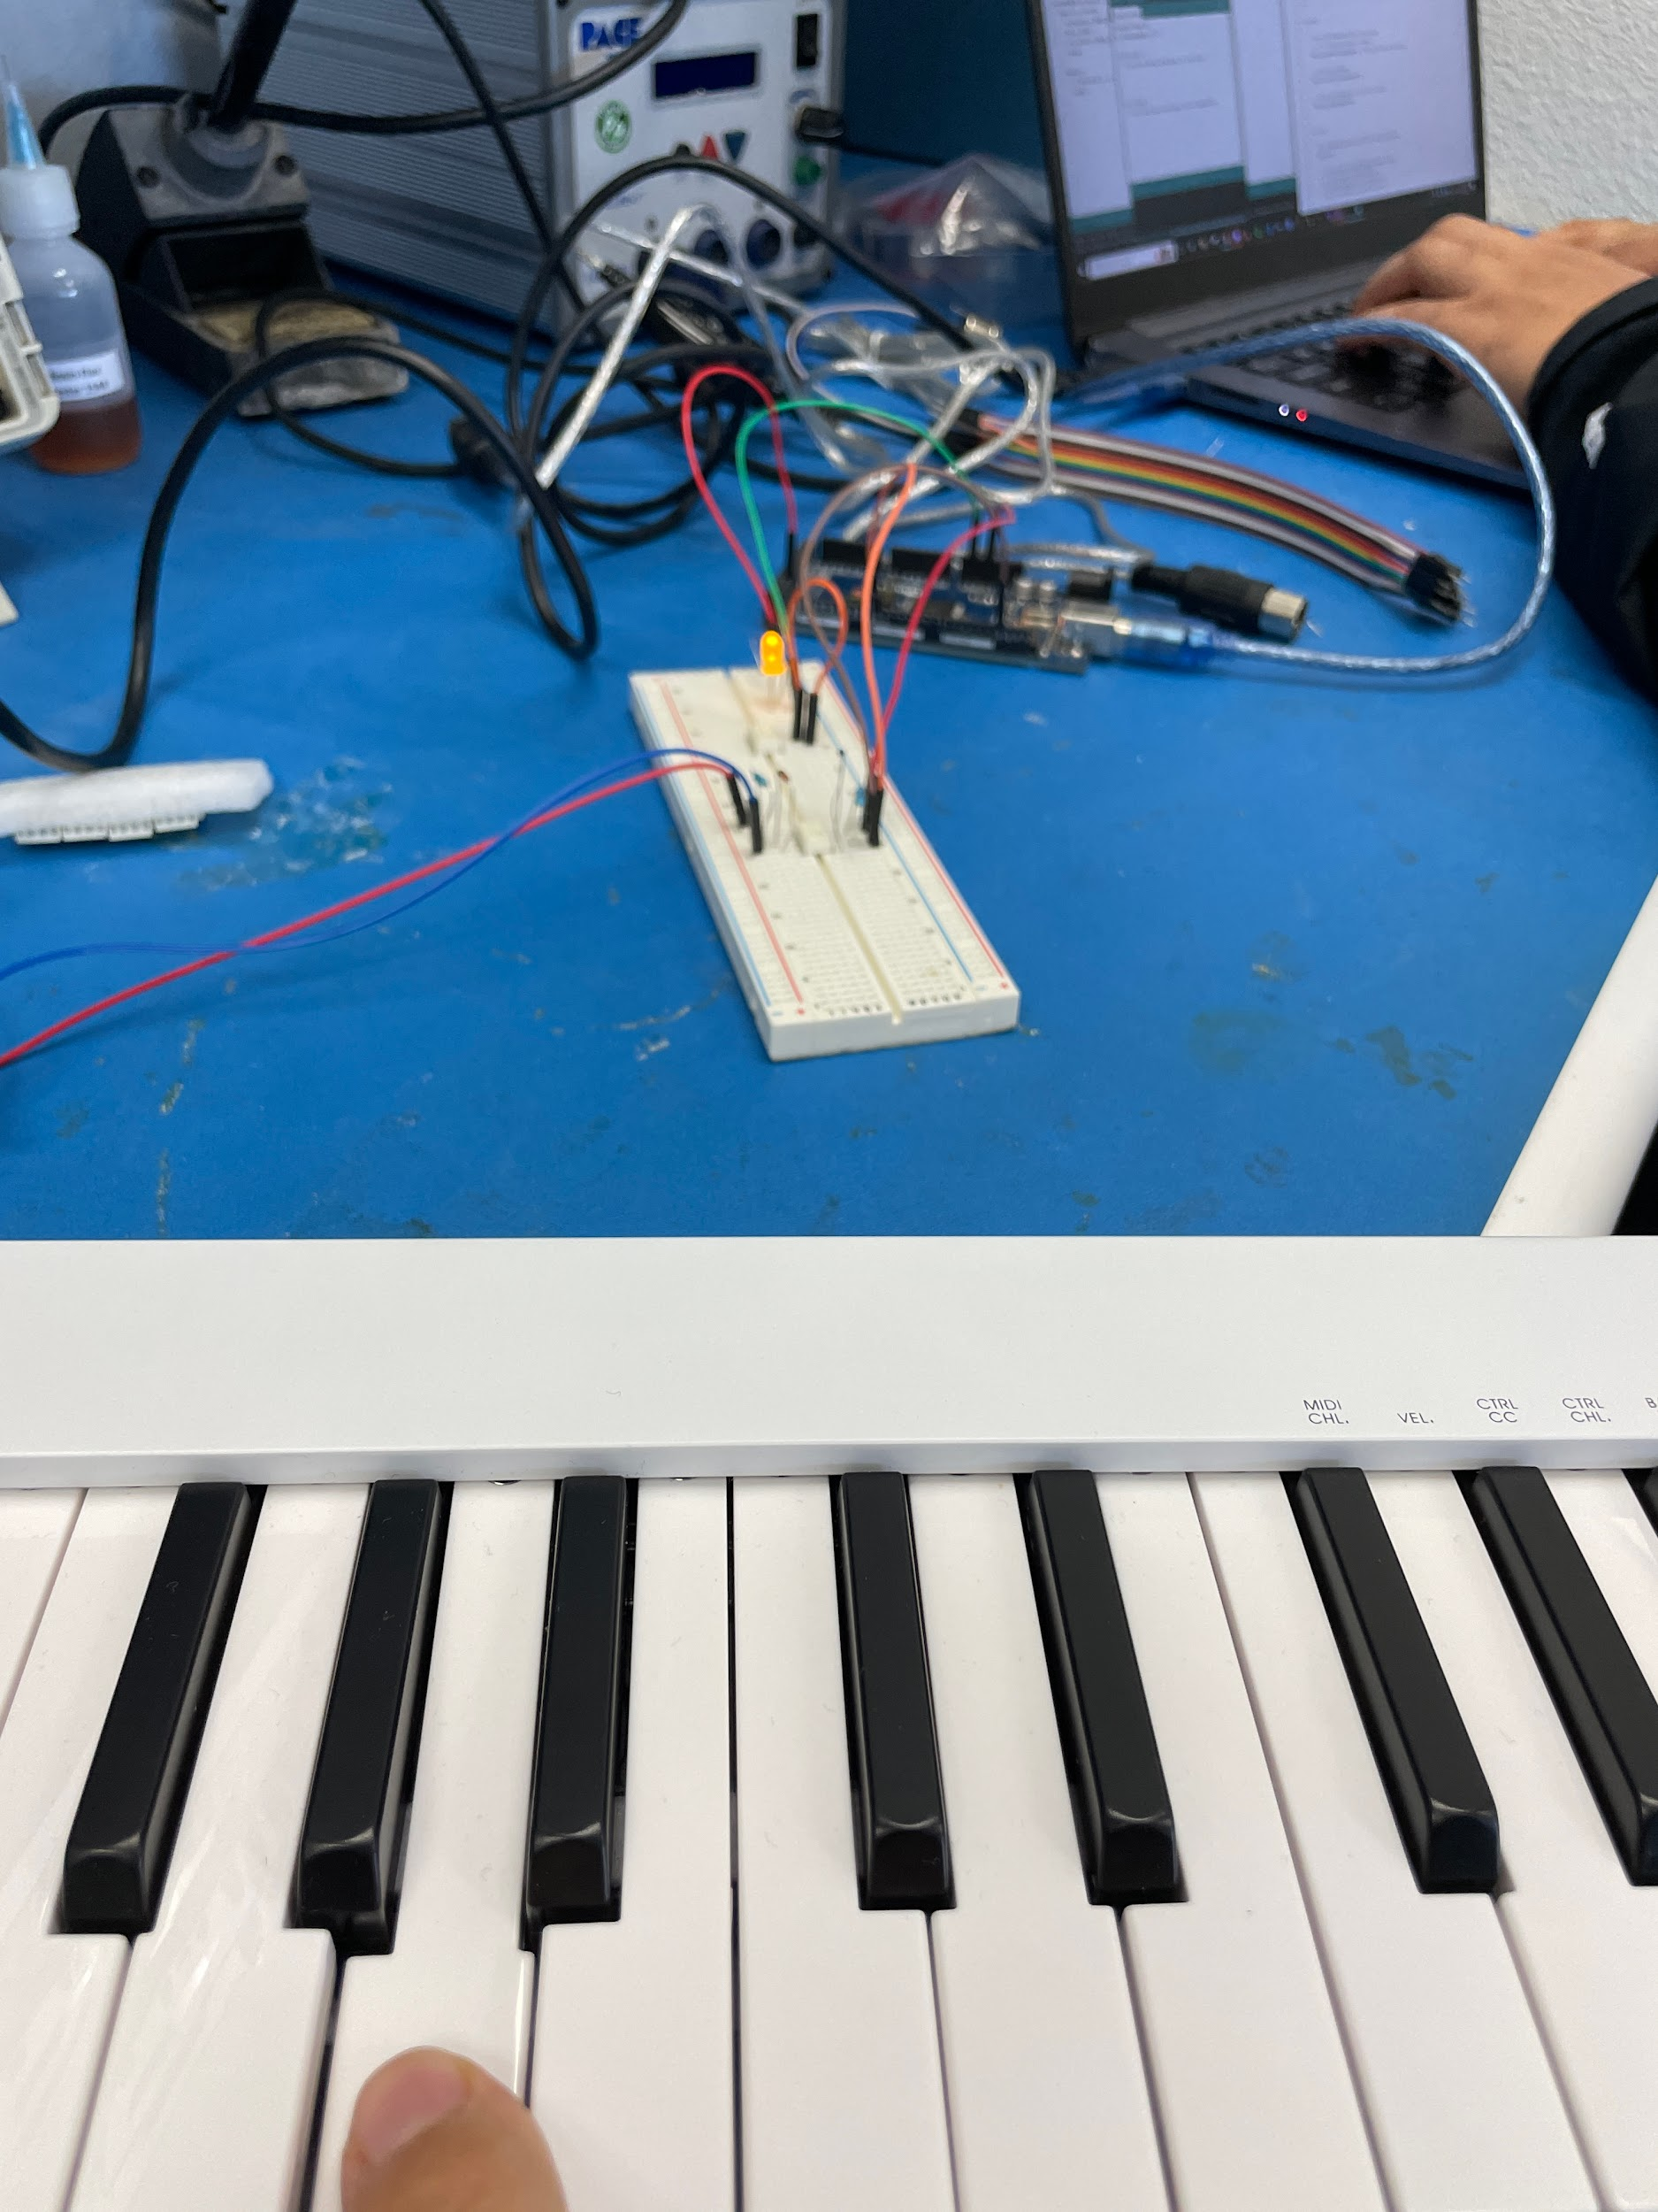
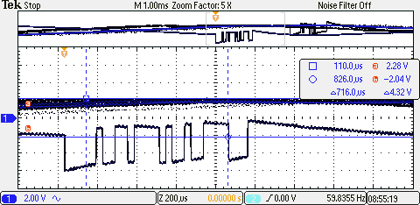
Risk Analysis - EMBEDDED
Parsing MIDI data
MIDI uses its own proprietary transmission of data
We implemented an Arduino header to be able to interpret to binary signals sent
Arduino has easier interpretation, so
Path 1 - we stay with Arduino and transmit to MiniZed
Path 2 - we translate into bare metal on the MiniZed
LED is lit
Bitwise MIDI data
Notes:
ELI

Slide 19
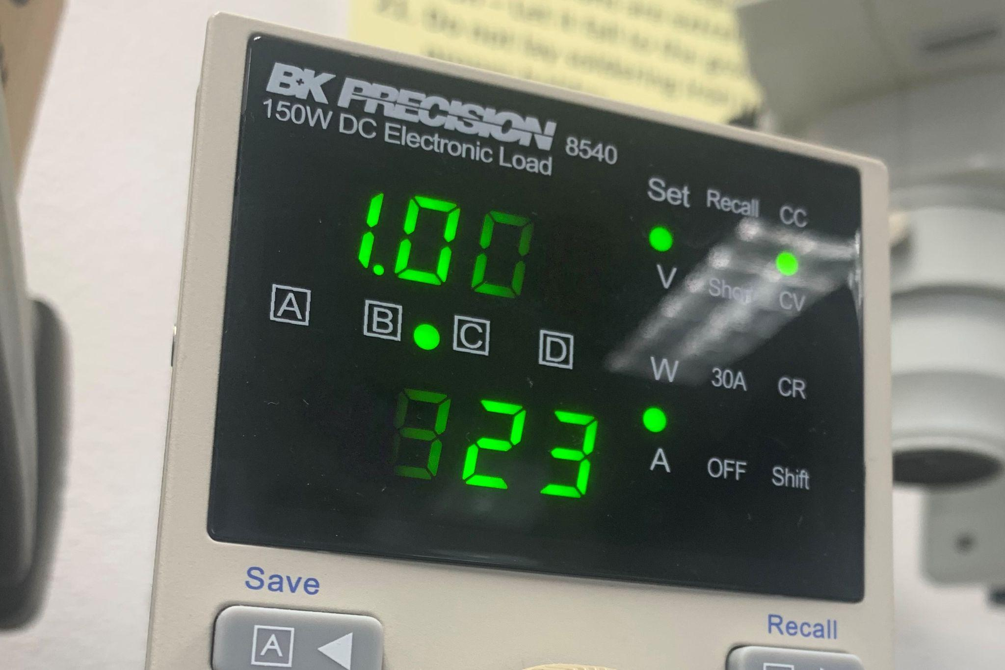
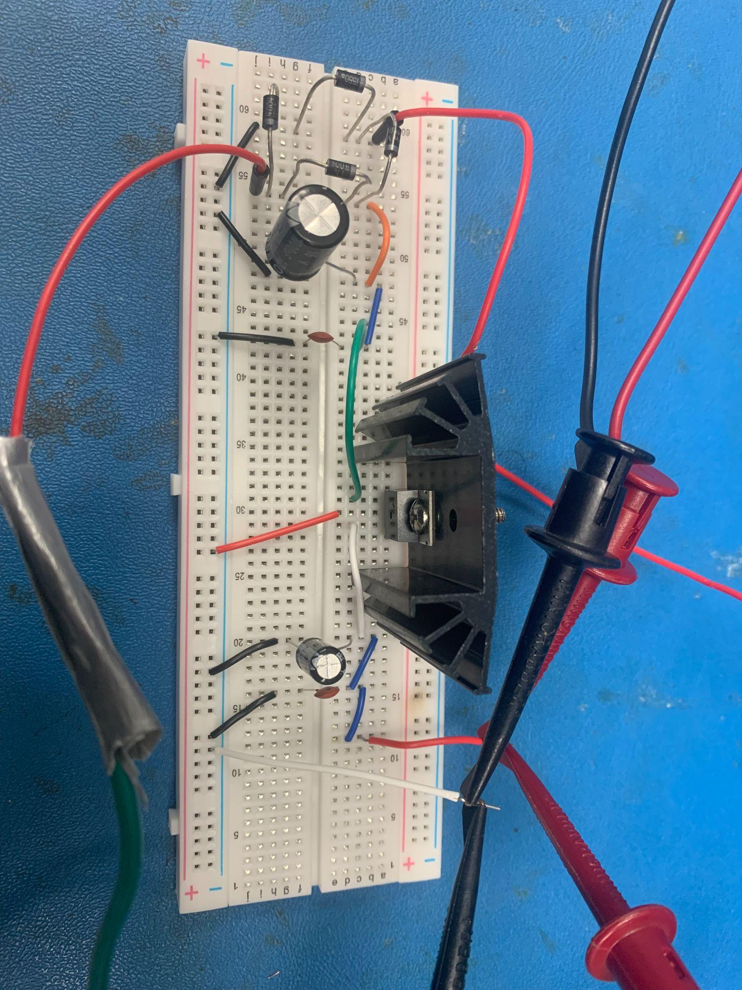
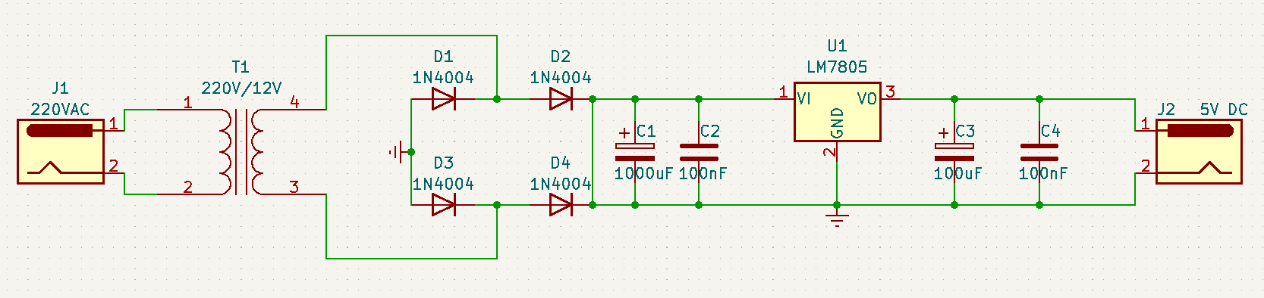
Risk Analysis - ELECTRICAL
POWER SUPPLY
Not enough power or constant voltage would cause the system to not be able to turn on or could cause damages to circuitry.
Mitigation solution: Design and test a power supply that could provide constant +5V at a maximum of 1A load.
Prototype power supply successfully provided these specifications.
Equipment used to apply load
Power supply on Breadboard
Power supply schematic
Notes:
WAS SUCESSFUL, NOT SHOWING HOW

Slide 20
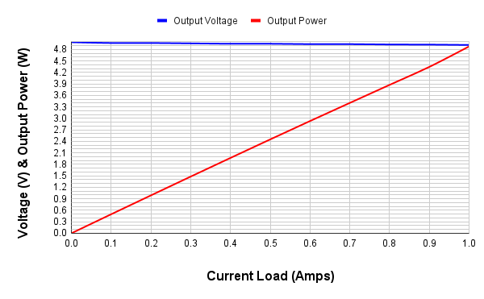
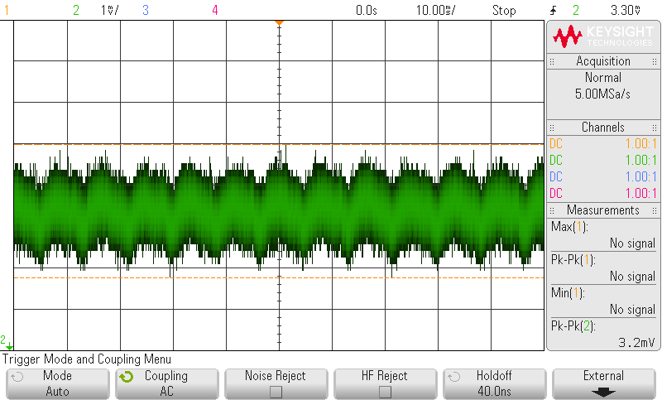
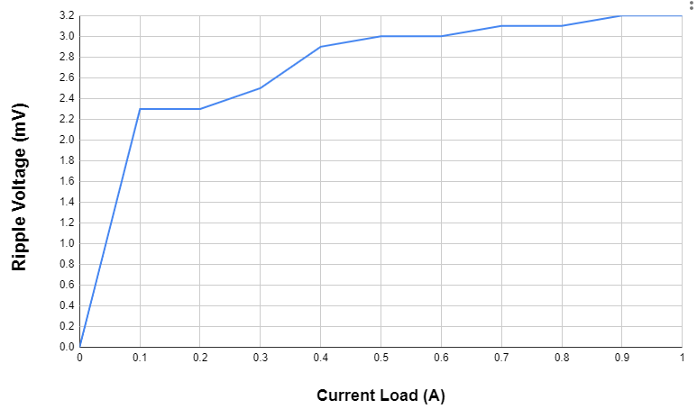
Risk Analysis - ELECTRICAL
Power supply provided constant voltage within 100 mV from +5V as load increased incrementally until maximum load was reached
Output ripple voltage is ~3.2mV peak to peak when max load is applied
Ripple voltage at full load
Notes:
HOW IT WAS SUCESSFUL
Mention low ripple = decrease heating and damaging capacitors/minimizing noise to audio circuits

Slide 21
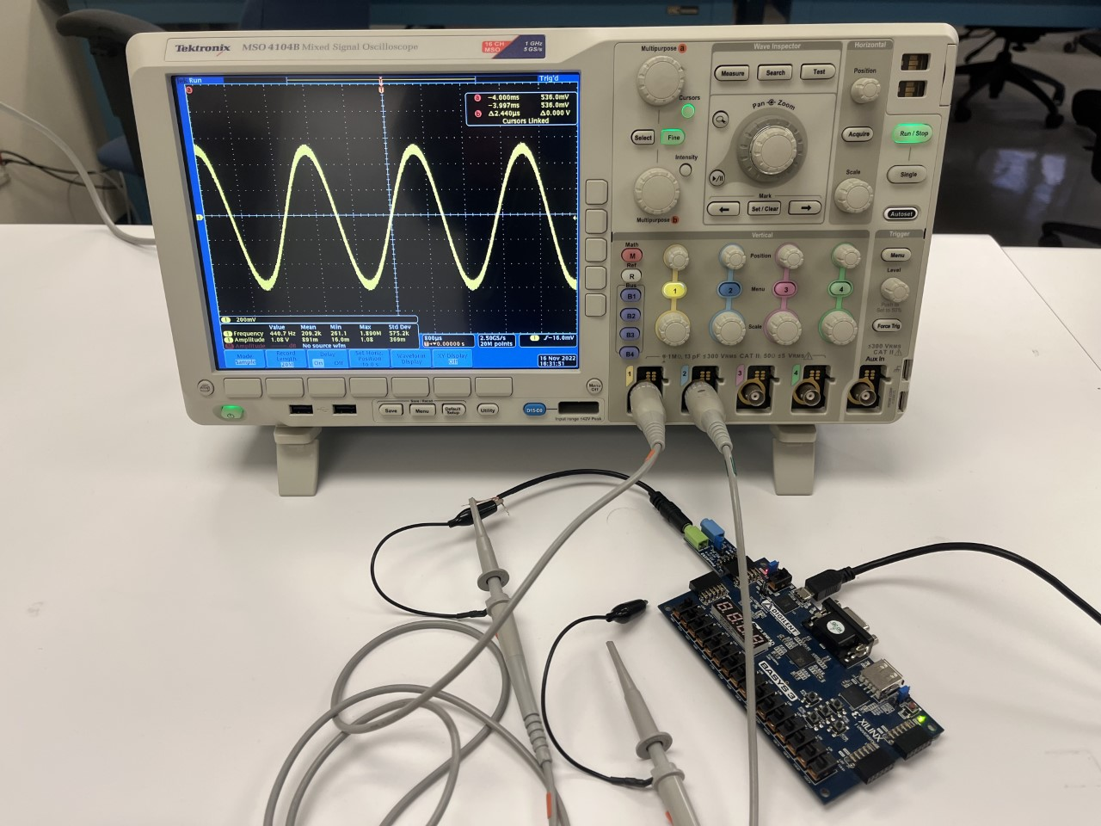
RISK ANALYSIS - FPGA
Implementing HDL datapath to generate sinusoidal signal
No trigonometric functions in FPGA
Designed numerically controlled oscillator
Successful prototype activity mitigated risk and optimized design
Prototype test setup

Slide 22
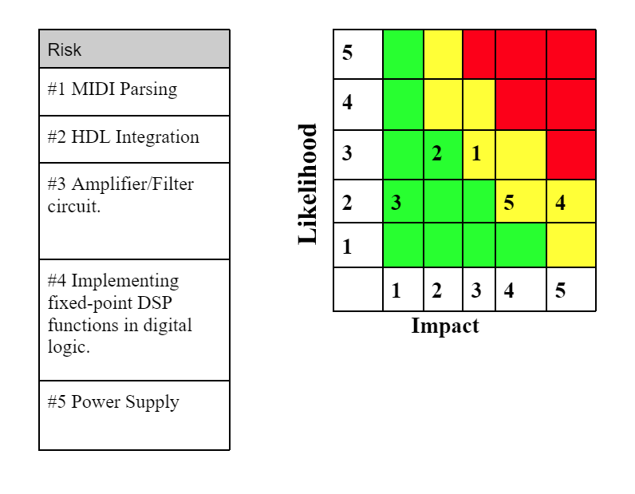
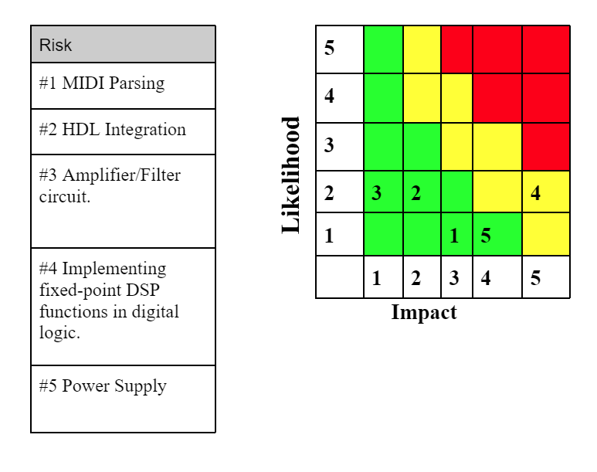
RISK ANALYSIS – RISK CUBE
1
BEFORE PROTOTYPING ACTIVITY
AFTER PROTOTYPING ACTIVITY

Slide 23
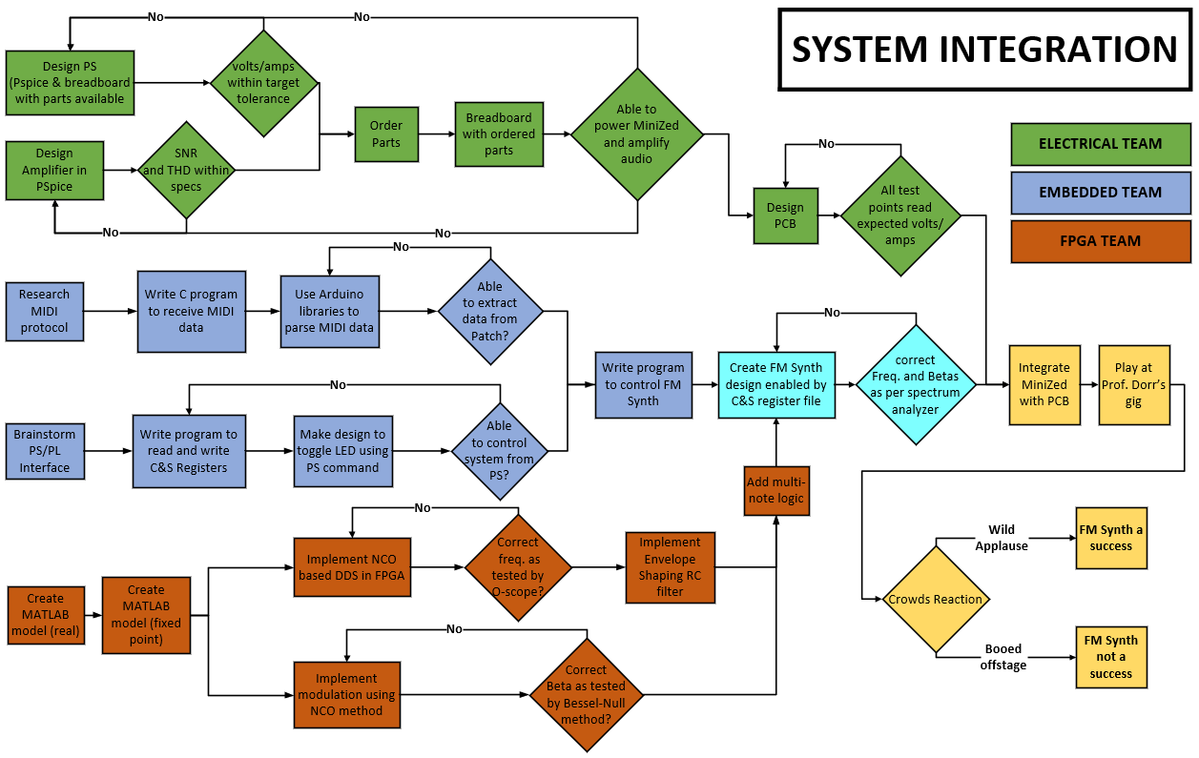
Notes:
TITO

Slide 24
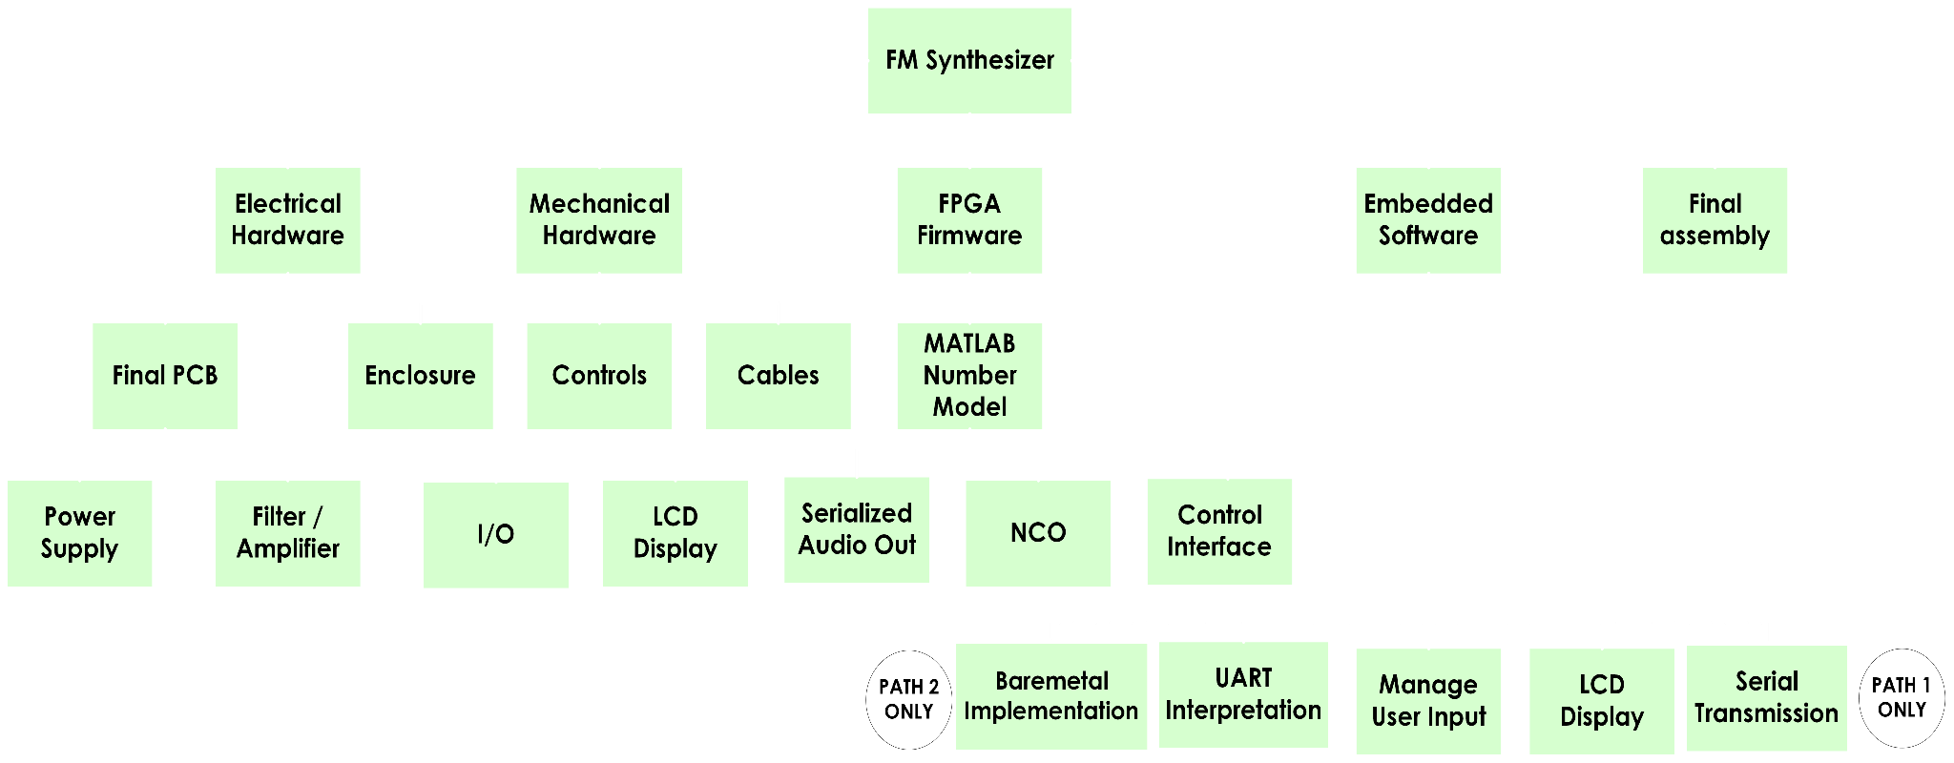
WORK BREAKDOWN STRUCTURE
No Arduino
Including Arduino
Notes:
TITO

Slide 25
TASK LIST AND SCHEDULING
Like if a conductor got digitized

Slide 26
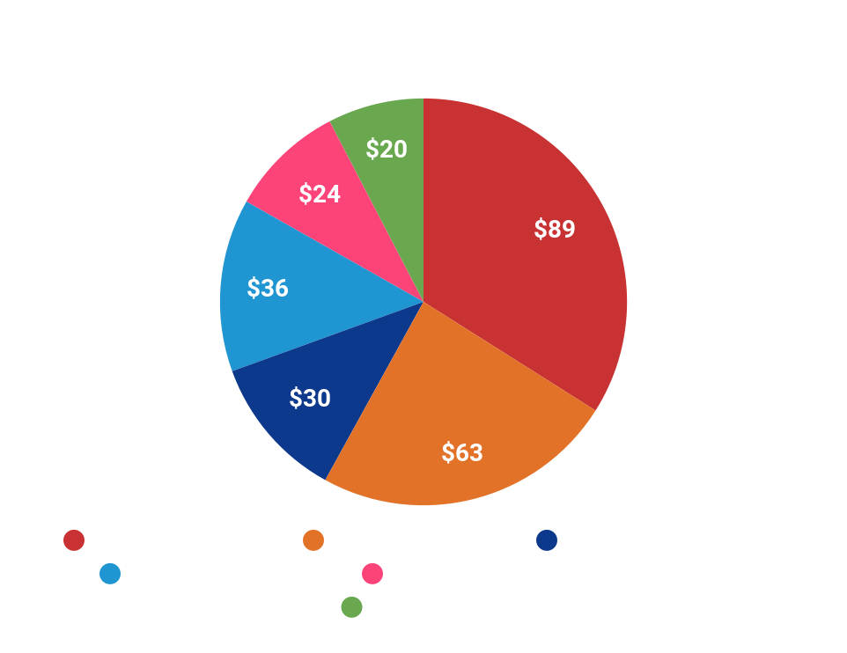
PROJECT COSTS
AVNET MINIZED SoC BOARD | $89
POWER SUPPLY | $63
MIDI PERIPHERALS | $30
PCB FABRICATION | $36
DAC & FILTERING COMPONENTS | $24
ENCLOSURE | $20
TOTAL | $262
Notes:
TITO

Slide 27
PROJECT FINANCING
Our prototyping has been self-funded
Parts were procured individually as it was rapid and cheap
Final project will use our allocated funds
Have 3 MiniZed boards - so no need to purchase
AVNET MINIZED SoC BOARD | Already procured
POWER SUPPLY | Transformer, heat sink, breadboard, and additional passive components
MIDI PERIPHERALS | MIDI Cables
PCB FABRICATION | Quote from JLCPCB
DAC & FILTERING COMPONENTS | CS4344 Audio Dac/Passive components
ENCLOSURE | Junction Box
Notes:
DAC and filtering components includes
TITO

Slide 28
Questions?

